Slide 1
Plant presentation
October 2025

Slide 2




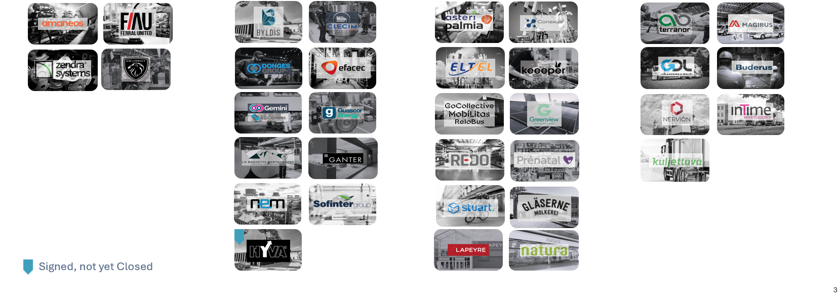


MUTARES
Current portfolio
Automotive & Mobility
Engineering & Technology
Goods & Services
Infrastructure & Special Industry
2

Slide 3


ZENDRA
Key message
ALL IN
ALL BLACKS
UN SOLO TEAM
UN SOLO OBIETTIVO
ZERO COMPROMESSI
Keeping Motion
in control
3

Slide 4
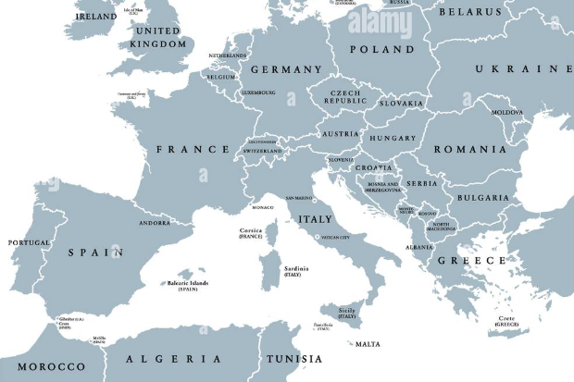
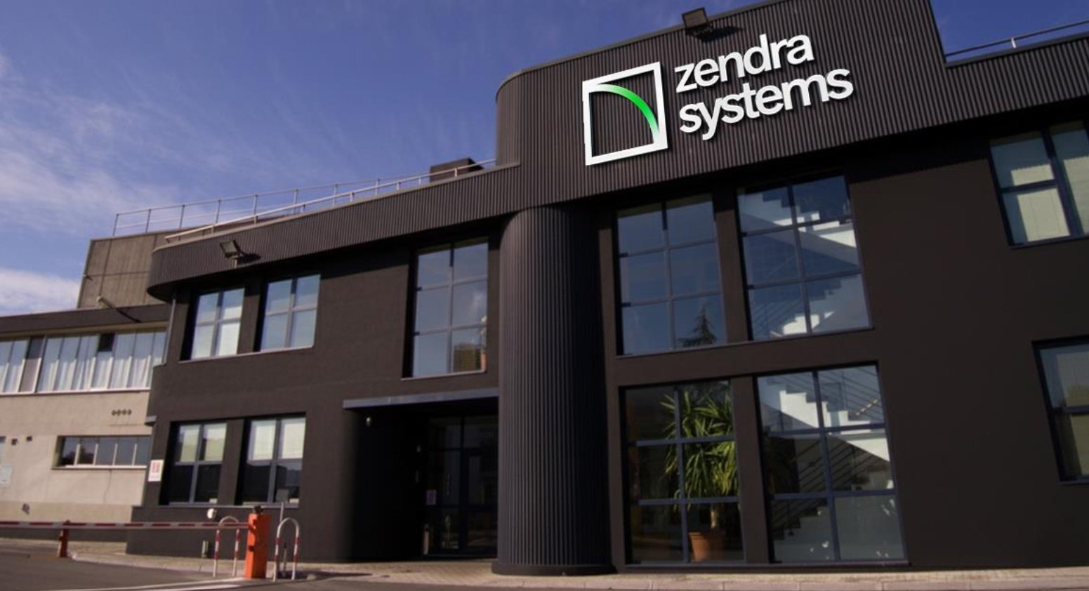
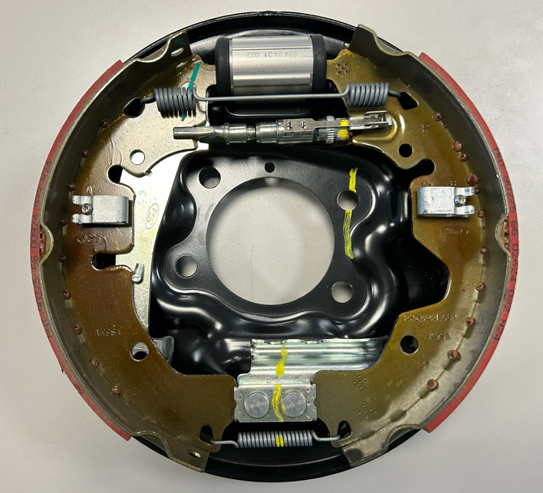
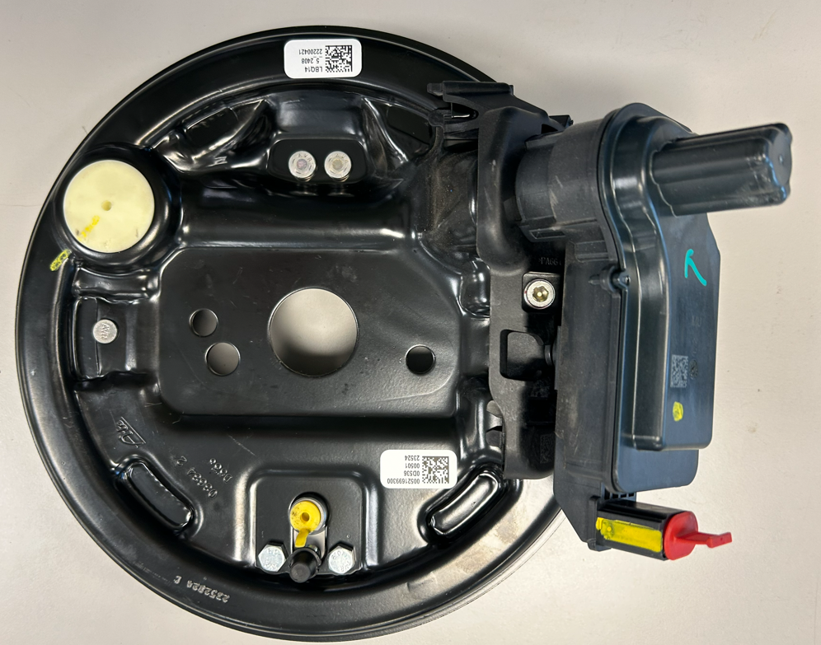
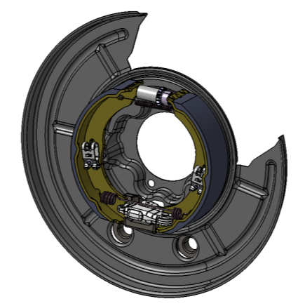
ZENDRA
General overview
Drum Brakes
Drum in Hat
EPB-Si
GENERAL OVERVIEW
Plant Size (SQM) Production : 16.135 Logistic : 2.320 TOTAL PLANT AREA : 52.000
Employees January 2025 TOTAL Heads : 388
Production 2024 Drum Brakes : 1.743.000 Drum in Hat : 456.000 EPB-Si : 1.079.000
4

Slide 5
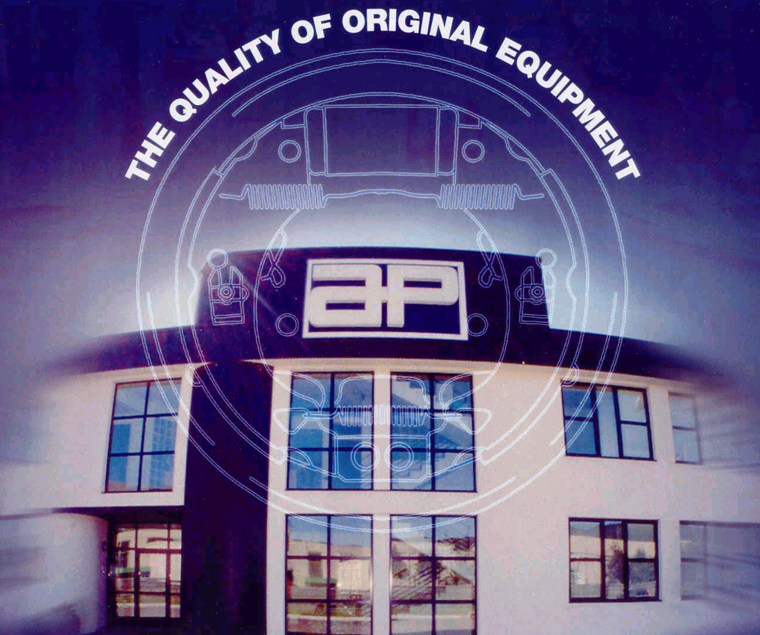
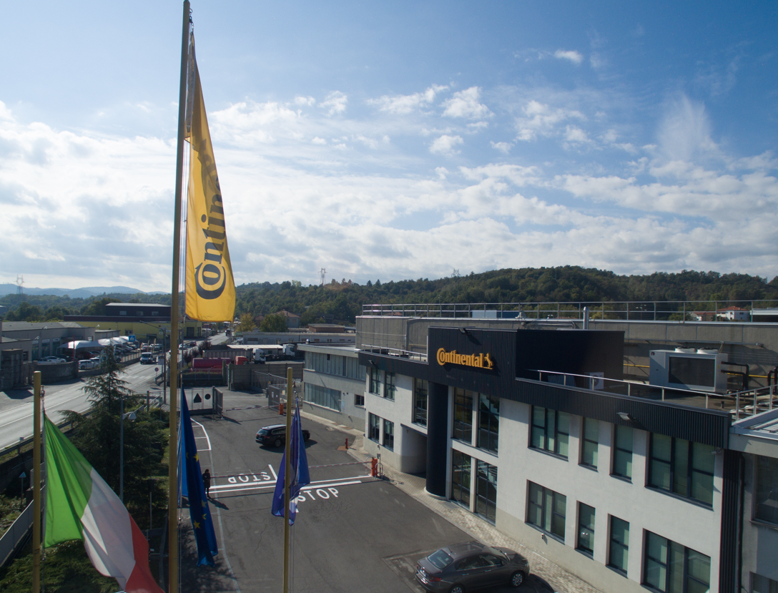
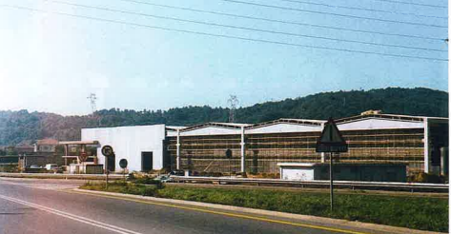


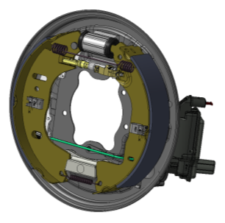
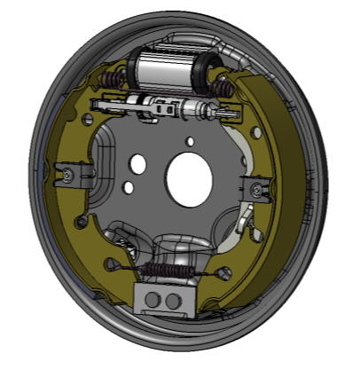
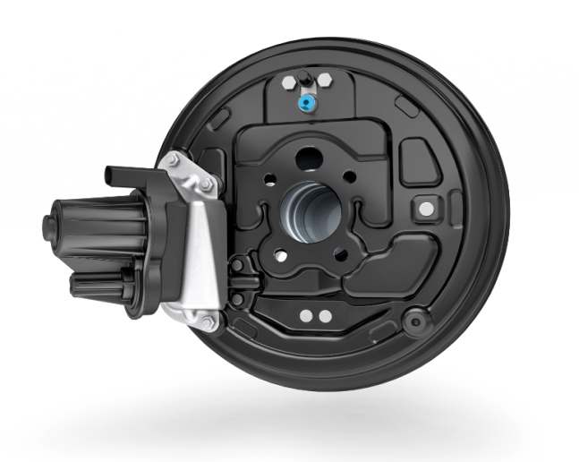
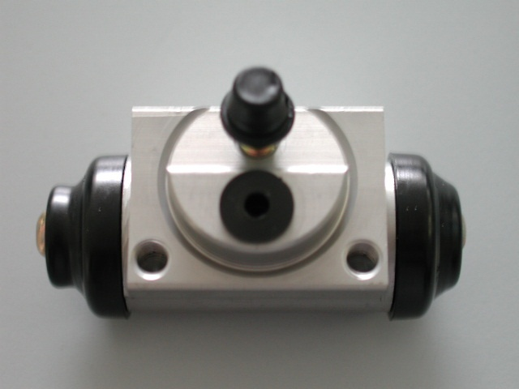

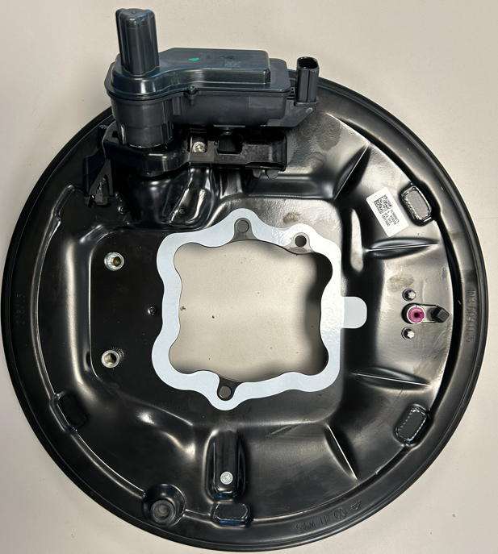
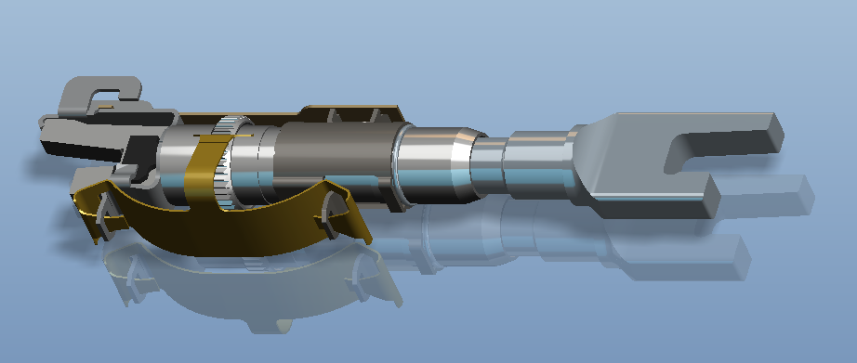
ZENDRA
Plant history
2001:
Changed into
Automotive Products Italia
2008:
Continental Brakes
October 2025:
Zendra Systems S.p.A.
1984:
Foundation of plant
(Automotive Products (Lockheed) S.p.A.)
2003:
Acquired by
PBR Italia Holdings srl
PLANT EVOLUTION from 1984 to 2025
1985:
Drum Brake
Fiat Group
1995:
Incremental Adjuster
1997:
Aluminium wheel cylinder
2001:
Drum in disc
with auto locking device
2016:
Electring Parking Brake
2019:
Electric parking brake SOP
MGU Assy Line
EPB-Si Assy Line
2004:
Relationship consolidation with
Ford, Renault, Nissan,
Toyota, GM, Land Rover
5

Slide 6

ZENDRA
Drum Brakes monthly evolution
2025 TOTAL:
3100 Mio Brakes
6

Slide 7










ZENDRA
Future forecasts are currently being
developed and will be made available
once completed
Sales per Customer Group
7

Slide 8
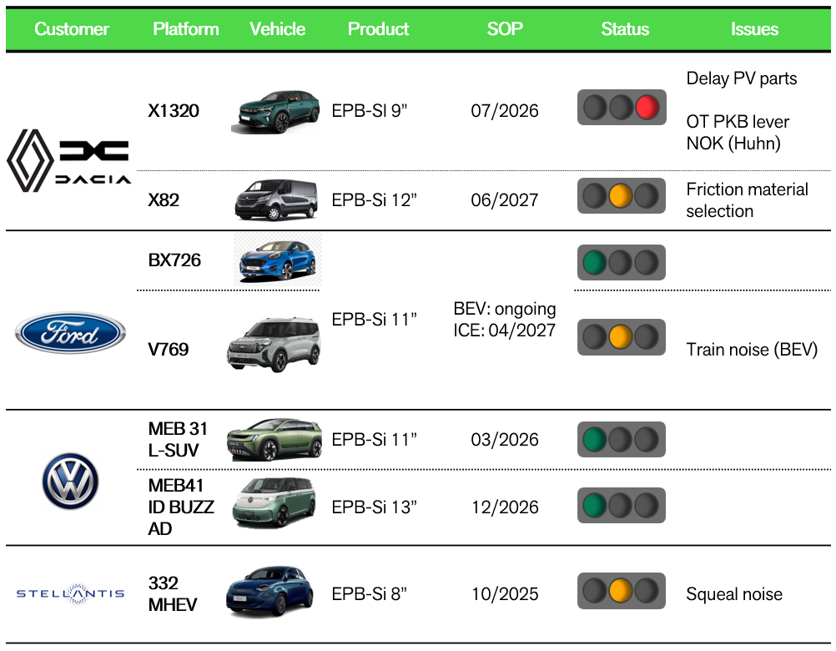
ZENDRA
New Projects
8

Slide 9
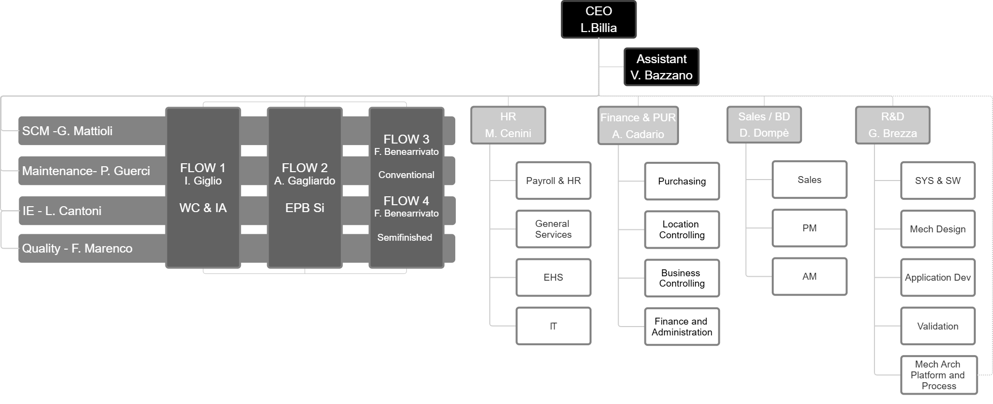
ZENDRA
Organization chart October 07, 2025
9

Slide 10
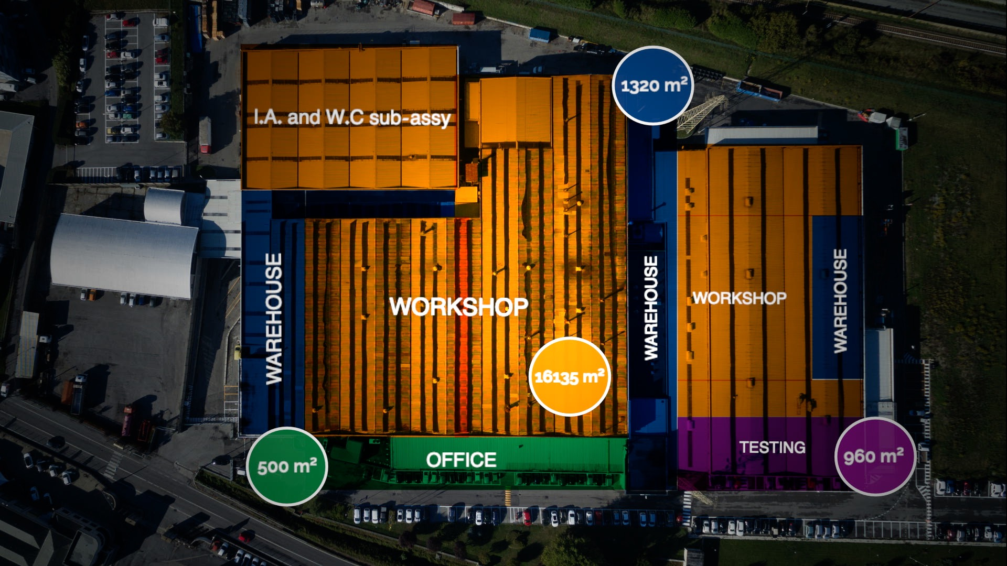
ZENDRA
External layout
TOTAL
52000 sqm
External
Warehouse
1000 m²
10

Slide 11
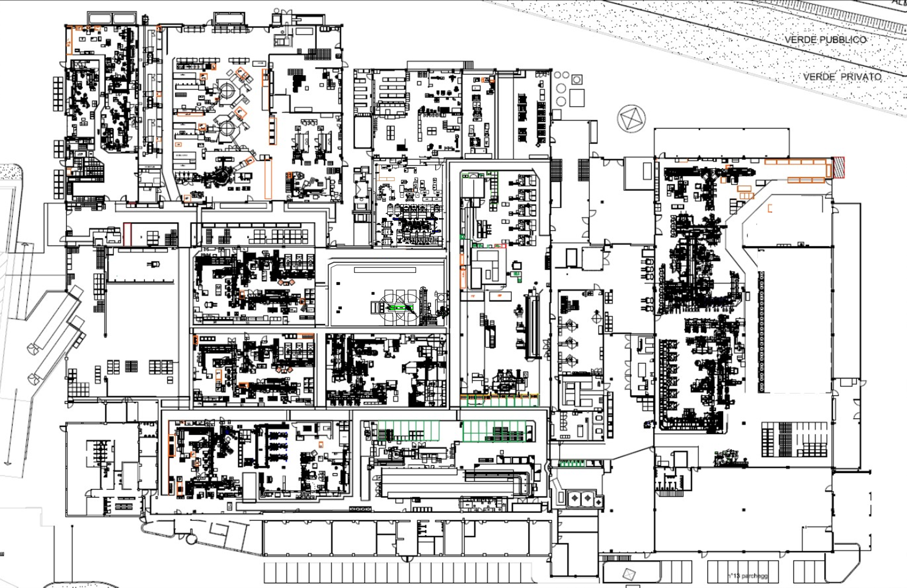
ZENDRA
Internal layout
1
2
6
Incremental Adjuster
2
1
Machining
3
Riveting machines
6
4
Lining glueing machines
3
8
7
5
Painting Line
4
6
EPBSi lines
10
10
7
MGU line
9
6
8
Line 14
9
Line 4 (Toyota, ..)
5
10
FIN Warehouses
11

Slide 12



ZENDRA
Certifications
ECE R 90
IATF 16949
Q1
ISO
50001
ISO
14001
CCC
(China Compulsory Product Certification)
ISO
45001
TISAX
12

Slide 13






ZENDRA
We take care of our Planet!
We claim to a solid and aligned environmental and energy performance of our products and processes. It is defined by the systematic and sustainable management of energy, emissions, resources and substances of concern (such as CO2, VOC, noise, dust, hazardous substances and wastes) operating an EMS according to ISO 14001.
OBJECTIVES TARGETS PROGRAMS
It is an annual document that allows to define the targets, control and monitoring of actions to improve environmental, safety, noise, energy and CO2 emission
KPIs
We monthly monitor the performance regardling to Energy consumption, CO2 emissions , water consumption, waste generation and waste sent for recycle
ENV. LEGISLATION
Determinations originated by the government, which we must compliance. We monitor it constantly thru a tool designed for it.
LANDFILL ZERO
A Project that claims to work under the 3R’s and not sending any wastes for landfill
ESH AND ENERGY POLICIES
Set of principles declared as commitments by top management
ENVIRONMENTAL AND ENERGY MANAGEMENT SYSTEM
Interdisciplinary management used to control and monitor activities for environmental gains.
Environmental aspects
They are what we generate and consume in our daily activities, which can cause impacts.
Environmental impacts
These are the consequences we cause to the environment.
ISO14001:2015
13

Slide 14
Thanks

